Slide 1

House Price Prediction Capstone Project
Santhosh Kumar C
DSBA SEPT-B BATCH
26-08-2022

Slide 2
Business Problem Understanding
Real estate agents are trusted with the communication between buyers and sellers as well as laying down a legal contract for the transfer. This just creates a middle man and increases the cost of houses
Buyers are generally not aware of the factors that influence the price of the house
House price prediction can help the developer determine the selling price of a house and can help the customer to arrange the right time to purchase a house.

Slide 3
Business Problem Understanding
House prices were determined by calculating the acquiring and selling price in a locality. Therefore, the House Price prediction model is very essential in filling the information gap and improve Real Estate industry efficiently
we can provide them House-Buying-Selling guiding services in the area so they can buy or sell their property with most suitable price tag
Buyers won’t lose their hard-earned money by offering low price or keep waiting for buyers by putting high prices

Slide 4
Model Building
For Predicting the House price, different types of classification algorithm’s & Ensemble models are used for model building
The below mentioned classification algorithm’s are used for modeling
Linear Regression
KNN Regression
Decision Tree Regression
Random Forest Regression
Gradient Boosting & Bagging

Slide 5
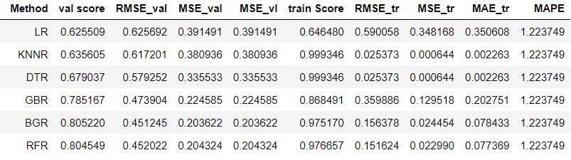
Model Comparison

Slide 6
Model Comparison
1. Linear regression – model has accuracy 64% in training set & 62% in validation set, hence Linear regression model cannot be considered for the tuning will look for the other better model performance
2. KNN – model has overfitted in training data results close to 100% & even though it has performed well in training data still the KNN regressor has performed poorly in the validation set resulting in only 63% accuracy – KNN model will not be considered for the Tuning
3. Decision Tree Regressor - Similar to KNN model, DTR model is overfitted in the training data with accuracy 100% & performed poorly in the validation set with accuracy 68% hence DTR model will not be considered for further tuning
4. Gradient Boosting regressor - It’s an ensemble technique which performed very good on both training data & validation set train data accuracy – 86%, validation set accuracy – 78% GBR model has good RMSE_val – 47%, MAPE – 12% is good and MSE value is 0.2022 which is good hence GBR is considered for tuning which might result the prediction in the validation set
5. Bagging Regressor - model has given excellent score in train data which is 97% seems close to overfitting & BGR model performed well in validation set and has accuracy 80%
6. Random Forest – Model has performed similarly to the BGR model has accuracy close to 97% & performed well in validation set as well with accuracy 80%

Slide 7
Hype-tuning using grid-search CV
From the above consolidated results of the different modeling, ensemble models have performed well on training and validation sets. Gradient Bagging regressor model will be selected for further analysis with hyper tuning and feature selection
GridSearchCV is the process of performing hyperparameter tuning in order to determine the optimal values for a given model. As mentioned above, the performance of a model significantly depends on the value of hyperparameters
1.estimator: Pass the model (Gradient Boost Regressor).
2.params_grid: the dictionary object that holds the hyperparameters you want to try
3.scoring: evaluation metric that you want to use, you can simply pass a valid string/ object of evaluation metric
4.cv: number of cross-validation you have to try for each selected set of hyperparameters

Slide 8
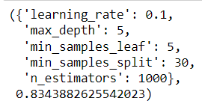
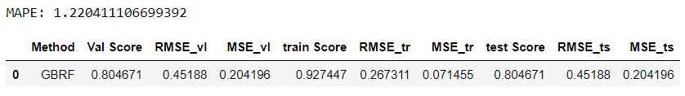
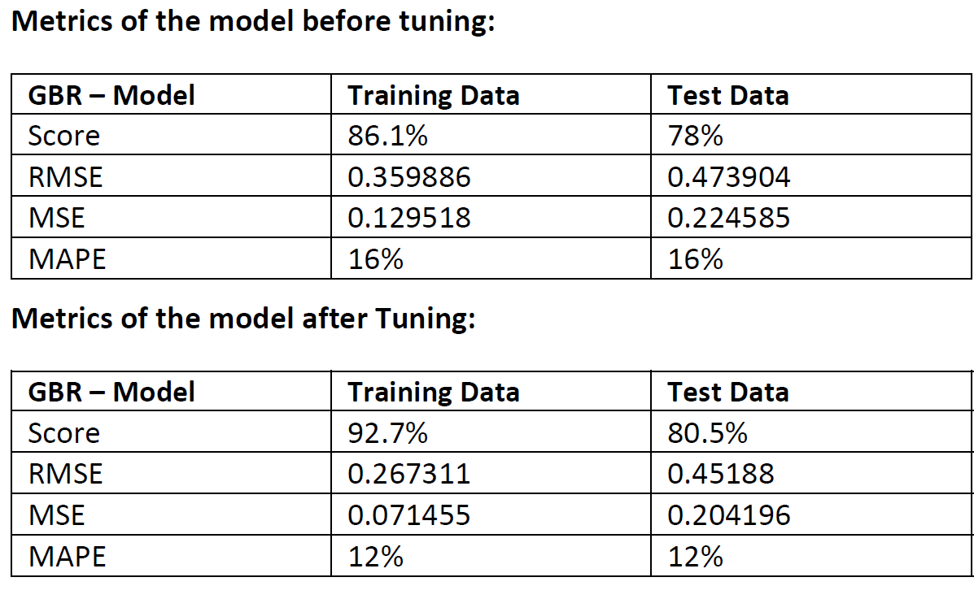
Grid-search CV
Out of 6 iterations found the best params using the grid search cv
For Iteration 4 with n_estimator: 100 the score was increased to 83.4%
After improving the model - Training data score is improved from 87 % to 92.7%
Test data score has improved from 78% to 81%
Mean absolute percentage error has been drastically reduced from 16% to 12% which is very good for the GBR model
RMSE value of both train & test has been reduced and stays close to 0 which indicates the model has predicted well in the test data with less error
MSE value of both train & test has been reduced well model which indicates the model has performed well in both train & test

Slide 9
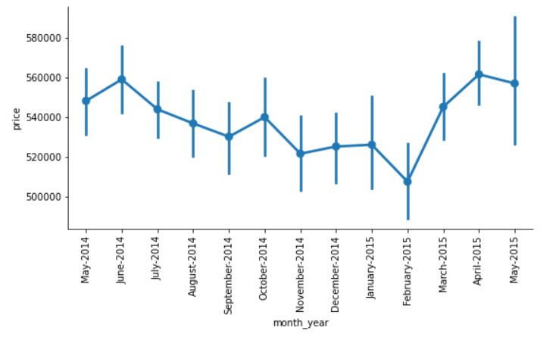
Business implication
“Quality_9.5” has been a second significant variable, so from this we can conclude that majority of the houses are sold were of quality – 9.5, people prefer the house with higher quality
“yr_built” – has contributed well in the model, this indicates majority of the people who are buying houses preferred to know the year built.
“lat”, “long”, “Zip Code” – for a house the location is very important, these three columns combined together considered as significant columns. Based on the zip codes, lat, long – variables if we can able to bag the houses in to categories such as (coastal region, metropolitan, apartment, individual villa) which will help in predicting the price better.
houses sold were mostly with bathroom minimum 3 & bedroom 5
Between April & May most of the houses were sold. People prefer buying the house at the start of the financial year

Slide 10
Recommendations
Also, if the data can provide information such as (nearby railway Station, Airport, Hospital, schools & colleges) this information will also help to predict the price better
This House-prediction was all about one city called Washington DC, where we are predicting only for this city, if we can add the house data similar to Washington DC cities like (Seattle, New York) the people who are buying/selling will get to know about the house prices across the metropolitan cities which helps them to conclude the price better & also gives them an additional choice of moving to another city or state

